Slide 1
Part (f) cont.

Slide 2
Modifying the magnitude of |Δk|
No other parameters changed.
Ratio of Δk’s remains equal.

Slide 3
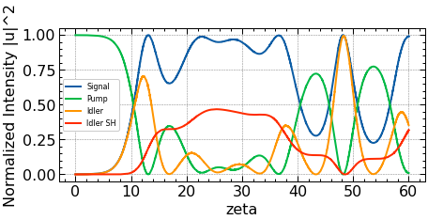
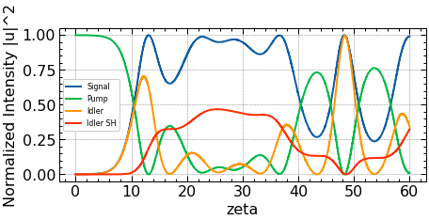
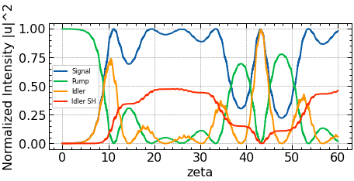
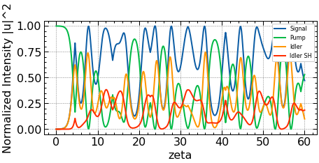
Δk_OPA = (10^5)*π, Δk_SHG = (1.2*10^5)*π
Δk_OPA = (1000)*π, Δk_SHG = (1200)*π
Δk_OPA = (10)*π, Δk_SHG = (12)*π
Δk_OPA = (0.1)*π, Δk_SHG = (0.12)*π

Slide 4
Modifying the gain (n_{p})

Slide 5
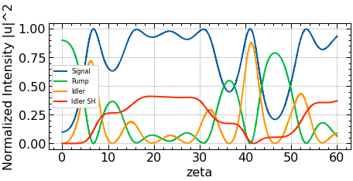
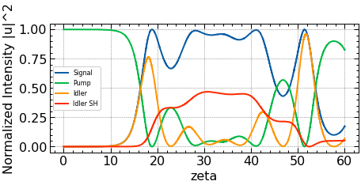
(Control; n_{p} = 0.999)
Lower gain (n_{p} = 0.9): Leads to a faster process
Higher gain (n_{p} = 0.99999): Slower process

Slide 6
Modifying the magnitude of initial amplitudes

Slide 7
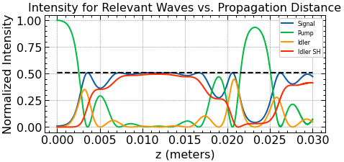
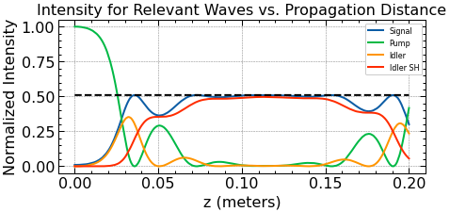
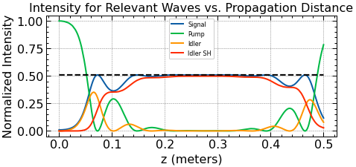
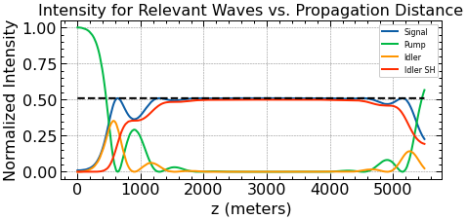
(Control)
Halved both initial amplitudes: a longer scale can be seen.
1/10 times the initial amplitudes
1/10000 times the initial amplitudes

Slide 8
Modifying C coefficients
We start with an underdamped oscillator with γ_{inf} (damping ratio) = 0.4, leading to an underdamped oscillator. We will change C coefficients with Norton and Sterke’s [1] methodology to achieve γ_{inf} = 1 (critical damping), and to achieve γ_{inf} = 2 (overdamped).

Slide 9
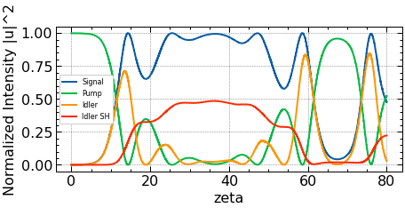
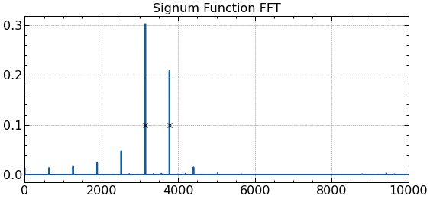
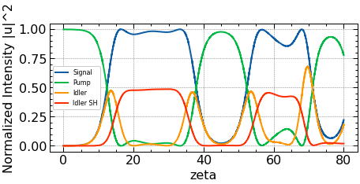
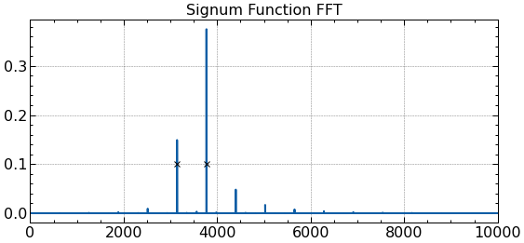
(control)
Making it so that the ratio of the square of fft peaks = 2.5 leads to critical damping (0.4*2.5 =1; required for critical damping).

Slide 10
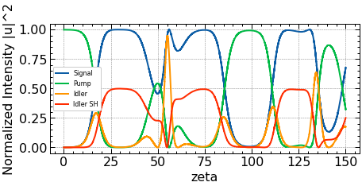
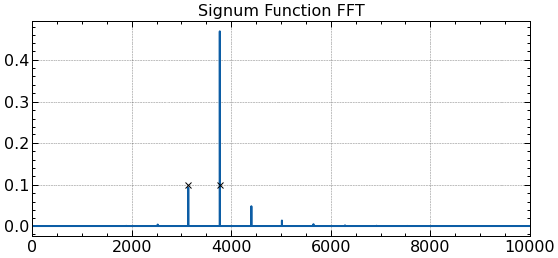
Raising the ratio of squares to 5 (s.t. 0.4*5 = 2; for overdamping) leads to clear overdamping.
Note: The ratio of C coefficients (C_SHG/C_OPA) only needed to be raised to 1.17 for critical damping, and 1.41 for overdamping.

